Slide 1
Using families to test causal claims without experiments
S. Mason Garrison
Vanderbilt University
Monday, February 4, 2019

Slide 2
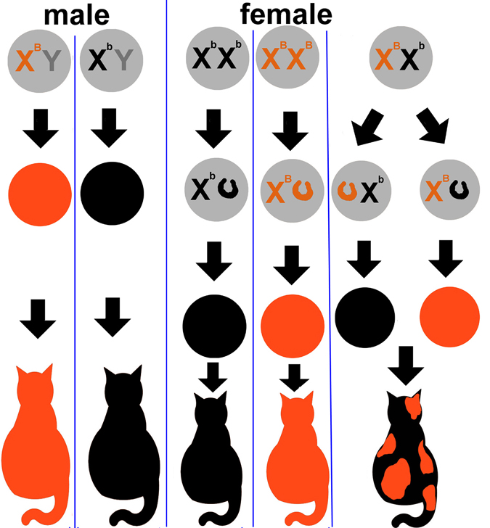
Outline
Motivation
Discordant Kinship Design
Empirical Illustration
Empirical Confirmation
Simulation

Slide 3
Causal Claims with Experiments
Randomized experiments are the “gold standard” for inferring causation in psychology.
Whenever possible, conduct a randomized experiment (Cochran & Chambers, 1965; Dorn, 1953).
Randomized experiments meet all criteria for making causal claims (See, West & Thoemmes, 2010)...
under Campbell’s approach to causal inference (Campbell, 1957; Shadish, Cook, & Campbell, 2002)
focused on eliminating plausible threats to validity; and
under the Rubin Causal Model (Holland, 1988; Rubin, 1974, 2005)
focused on making verifiable assumptions.

Slide 4
Causal Claims with Experiments
The design features of randomized experiments are fundamentally appealing:
treatment assignment is objective,
they are “automatically designed without access to any outcome data,”(Rubin, 2008) and
all pre-treatment covariates are “balanced” across conditions.

Slide 5
Causal Claims without Experiments
However, questions posed by psychology cannot always be answered with experiments.
Particularly, within the context of the socioeconomic status (SES)-health gradient.
The gradient is the consistent positive relationship between SES and health, that persists across time, place, and method of assessment.
If you are interested in
outcomes,
causes, or
exogenous change.

Slide 6
Causal Claims without Experiments
However, questions posed by psychology cannot always be answered with experiments.
Particularly, within the context of the SES-health gradient.
If you are interested in
outcomes that
are rare or unique,
are long-term,
(e.g., longevity; Jackson, Connolly, Garrison, et al, 2015 @ Psych Science) or
require expensive designs
causes, or
exogenous change.

Slide 7
Causal Claims without Experiments
However, questions posed by psychology cannot always be answered with experiments.
Particularly, within the context of the SES-health gradient.
If you are interested in
outcomes,
causes that
cannot be manipulated,
(e.g, intelligence, Garrison & Rodgers, 2016 @ Intelligence; personality, Garrison & Rodgers, R&R @ EJP; Jackson, Connolly, Garrison, et al, 2015)
should not be manipulated, or
(e.g, discrimination, Garrison, Doane, & Elliott, 2018 @ SPPS; SES Garrison & Rodgers, in press @ JPSP; unemployment, Schultz, Connolly, Garrison, Leveille, & Jackson, 2017 @ JRP)
are too expensive to be manipulated; or
exogenous change.

Slide 8
Causal Claims without Experiments
However, questions posed by psychology cannot always be answered with experiments.
Particularly, within the context of the SES-health gradient.
If you are interested in
outcomes,
causes, or
exogenous change
(i.e., effects holding all other variables constant),
rather than net effects (Todd & Wolpin, 2003).

Slide 9
Causal Claims without Experiments
Instead, we use quasi-experimental designs,
and control for potential confounds as covariates (Campbell, 1957; Rubin, 1974, etc);
e.g. Schultz, Connolly, Garrison, et al, 2017; Jackson, Connolly, Garrison et al, 2015)
Unlike randomized experiments, most quasi-experimental designs
cannot objectively assign treatment,
are not “automatically designed without access to any outcome data,” and
cannot always balance relevant pre-treatment covariates across conditions.

Slide 10
Familial Confounds
The typical use of covariates doesn’t control for systematically confounded gene and environmental effects (e.g., familial effects).
In psychology, familial effects covary with virtually all constructs (Polderman et al, 2015),
Including poverty and individual differences, so much so that
the covariate approach is fundamentally biased (Rowe & Rodgers, 1997).
Yet, the covariate approach is the main method used to test
the relationship between SES and health.

Slide 11
Familial Confounds
When present, familial effects bias the covariate approach in at least two ways:
When predictor and outcome share familial effects, familial confounds remain and bias the treatment effect.
When covariate and outcome share familial effects, familial causes are over-controlled and are potentially excluded from the treatment effect.

Slide 12
How to address familial confounding?
Rather than bemoan or ignore familial effects,
they can to be harnessed for causal inference.
Biometrically-Informed Quasi-Experimental Designs include,
“quasi-causal” behavior genetic models (Turkheimer, & Harden, 2014),
co-twin controls (Gesell, 1942), which compare twins,
sibling controls (Griliches, 1979), which compare full-siblings;
children-of-twins designs, which compare the children of twins; and
discordant kinship models (Garrison & Rodgers, 2016), which can compare any kin group.
Notes:
These kin comparison designs

Slide 13

A Brief Behavior Genetics Refresher

Slide 14
Brief Behavior Genetics Refresher
Like Kin Comparison Designs, Behavior Genetic Models divide variance into multiple sources:
Between-Family (Familial Effects)
Within-Family
But, unlike Sibling Comparison Designs, Behavior Genetic Models divide variance into three sources:
Between Family
Heritable (a²)
Shared Environment (c²)
(which can be further decomposed into rearing and community effects; Garrison, et al. 2018)
Within-Family
Non-Shared Environment (e²)

Slide 15
Multiple Environment Components (AC'RE)

Slide 16
AC'RE
AC'RE further decomposes the shared-environmental variance (c²)
into
R is the rearing environment
(raised in the same home)
e.g., HOME, Parenting
C' is the community environment
(raised in same community)
Or the shared-environmental correlations, not explained by rearing
C’= C-R
R+C'= shared environment (C)

Slide 17
AC'RE
cor_{r} =1 or 0
cor_{a}= r
e₁
r₁
a₁
a₂
r₂
e₂
c'
λ_{e} λ_{r} λ_{a}
λ_{a} λ_{r} λ_{e}
Height₁
λ_{c'} λ _{c'}
Height₂

Slide 18
AC'RE
cor_{r} =1 or 0
cor_{a}= r
e₁
r₁
a₁
a₂
r₂
e₂
c'
λ_{e} λ_{r} λ_{a}
λ_{a} λ_{r} λ_{e}
Height₁
λ_{c'} λ _{c'}
Height₂

Slide 19
AC'RE
cor_{r} =1 or 0
cor_{a}= r
e₁
r₁
a₁
a₂
r₂
e₂
c'
λ_{e} λ_{r} λ_{a}
λ_{a} λ_{r} λ_{e}
Height₁
λ_{c'} λ _{c'}
Height₂

Slide 20
AC'RE
cor_{r} =1 or 0
cor_{a}= r
e₁
r₁
a₁
a₂
r₂
e₂
c'
λ_{e} λ_{r} λ_{a}
λ_{a} λ_{r} λ_{e}
Height₁
λ_{c'} λ _{c'}
Height₂

Slide 21
Half Siblings
cor_{r} =1
cor_{a}=.25
e₁
r₁
a₁
a₂
r₂
e₂
c'
λ_{e} λ_{r} λ_{a}
λ_{a} λ_{r} λ_{e}
Height₁
λ_{c'} λ _{c'}
Height₂

Slide 22
Aunt-Nibling
cor_{r} =0
cor_{a}=.25
e₁
r₁
a₁
a₂
r₂
e₂
c'
λ_{e} λ_{r} λ_{a}
λ_{a} λ_{r} λ_{e}
Height₁
λ_{c'} λ _{c'}
Height₂

Slide 23
Siblings
cor_{r} =1
cor_{a}=.5
e₁
r₁
a₁
a₂
r₂
e₂
c'
λ_{e} λ_{r} λ_{a}
λ_{a} λ_{r} λ_{e}
Height₁
λ_{c'} λ _{c'}
Height₂

Slide 24
Parent-Child
cor_{r} =0
cor_{a}=.5
e₁
r₁
a₁
a₂
r₂
e₂
c'
λ_{e} λ_{r} λ_{a}
λ_{a} λ_{r} λ_{e}
Height₁
λ_{c'} λ _{c'}
Height₂
Mom
Child

Slide 25
Parent-Child
cor_{r} =0
cor_{a}=.5
_{Allowed to Covary}
e₁
r₁
a₁
a₂
r₂
e₂
c'
λ_{e} λ_{r} λ_{a}
λ_{a} λ_{r} λ_{e}
Height₁
λ_{c'} λ _{c'}
Height₂
Mom
Child

Slide 26
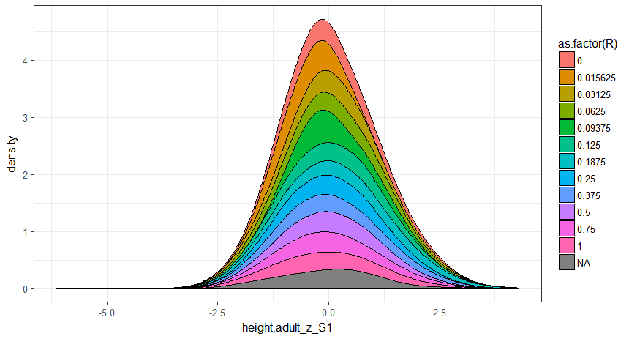
Illustration with Height
Relatedness
Median Height after age 18,
Standardized by sex, using CDC norms
Standardized Height

Slide 27
Adult Height
Model Fit
RMSEA [90 CI] | .016 [.009,.023]
CFI,TLI | .99
χ² Model Fit | p(67.3,40)=.005
χ² Contribution by Group (pairs)
MZ twins (16+13) | 6.8 | 0.8
Full Siblings (4683+5005) | 9 | 4.3
Parent-Child (6087+5390) | 10.9 | 8.7
Half Siblings (827+2563) | 0.7 | 2.8
Aunt-Nibling (3548+3963) | 0.5 | 3.7
Cousins together (25+71) | 2 | 9
Cousins apart (1670+2509) | 2.6 | 5.4
Total: 36,370
e₁
r₁
a₁
λ_{e} λ_{r} λ_{a}
c'
Height₁
λ_{c'}
λ_{c'}
Standardized by sex, using CDC norms; grouped by minority status; clustered by household.

Slide 28
Adult Height
Estimate (CI95) | non-minority | minority
a² | 88 [81, 96] | 80 [68, 93]
c'² | 0 [0, .001] | 4.6 [.3, 14]
r² | 0.3 [0, 7.7] | 0.25 [0, 9.9]
e² | 11 [5.4, 19] | 15 [8.7, 24]
e₁
r₁
a₁
λ_{e} λ_{r} λ_{a}
c'
Height₁
λ_{c'}
λ_{c'}
Standardized by sex, using CDC norms; grouped by minority status; clustered by household.
Notes:
Rearing, community correlation for parent-child, was not significant for either group

Slide 29
Interpretation
Estimates for Height were comparable to
twin data (Polderman, et al., 2015), and
consistent with other findings of racial differences.
c'² likely reflects nutritional deficits or the impact of poverty.
Small effect would likely have remained undetected in classic applications.

Slide 30
Summary
Application of large kinship samples gives comparable estimates
to twin data
with representative sampling, and
power to detect small effects.
We’ve applied these designs to other measures, including education, BMI
Multiple generations provide an added twist on environmental estimates

Slide 31
Brief Behavior Genetics Refresher
Between Family
Heritable (a²)
Genes
Biological relatives are more similar than non-biological relatives
The more related you are, the more similar you’re expected to be
Shared Environment (c²)
Household (or Herd)
creates similarities within families regardless of relatedness
Within-Family
Non-Shared Environment (e²)
Outside the Household
Error

Slide 33
Classic Biometrically-Informed Quasi-Experimental Designs
Classic versions of these models rely on rare events, such as twins, or advanced methods (e.g., behavior genetics; SEM)
They support causal inference without random assignment, and
incorporate familial effects (Lahey & D’Onofrio, 2010; Rutter, 2007).
Yet, such models are underused in psychology (Rodgers, Cleveland, van den Oord, & Rowe, 2000).
Classic models impose barriers, which deter researchers from using sibling-based models.

Slide 34
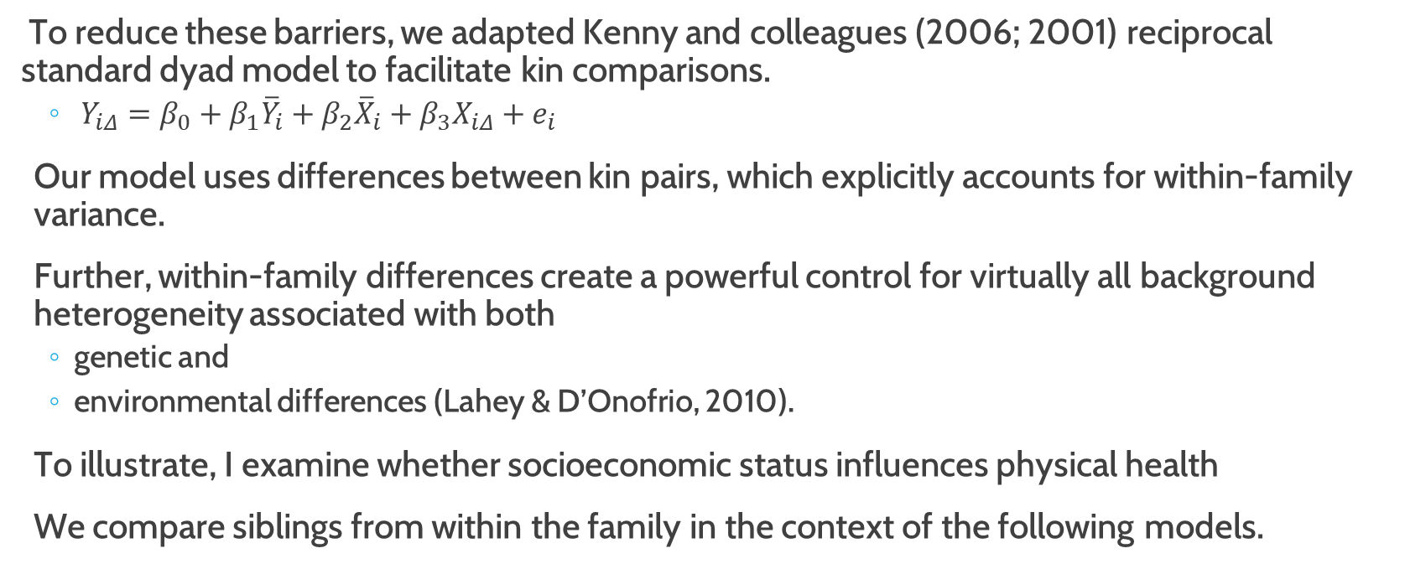
Sibling Models
To reduce these barriers, we adapted Kenny and colleagues (2006; 2001) reciprocal standard dyad model to facilitate kin comparisons.
$Y_{iΔ}=β_{0}+β_{1}{\overline{Y}}_{i}+β_{2}{\overline{X}}_{i}+β_{3}X_{iΔ}+e_{i}$
Our model uses differences between kin pairs, which explicitly accounts for within-family variance.
Further, within-family differences create a powerful control for virtually all background heterogeneity associated with both
genetic and
environmental differences (Lahey & D’Onofrio, 2010).
To illustrate, I examine whether socioeconomic status influences physical health
We compare siblings from within the family in the context of the following models.

Slide 35
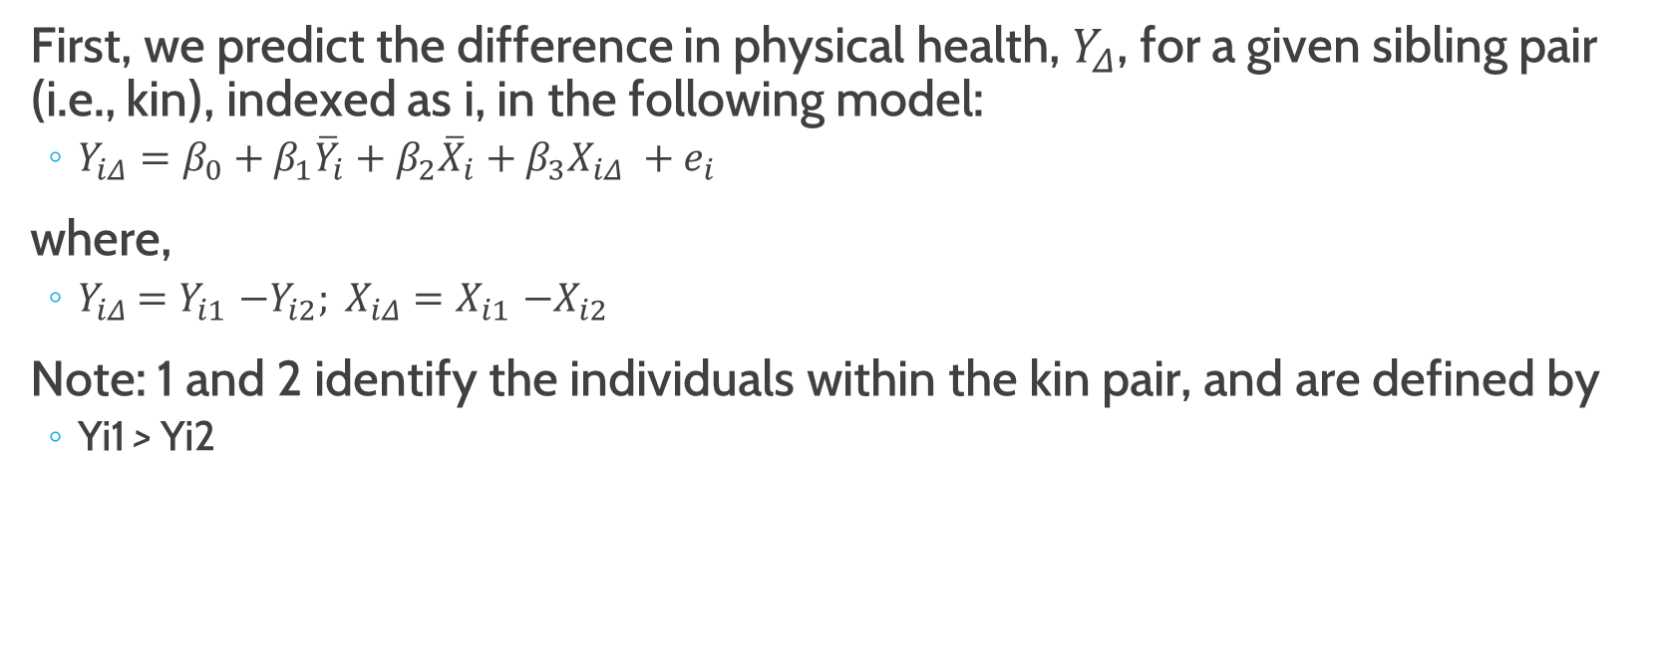
Discordant Kin Model
First, we predict the difference in physical health, $Y_{Δ}$, for a given sibling pair (i.e., kin), indexed as i, in the following model:
$Y_{iΔ}=β_{0}+β_{1}{\overline{Y}}_{i}+β_{2}{\overline{X}}_{i}+β_{3}X_{iΔ} +e_{i}$
where,
$Y_{iΔ}$ ${=Y}_{i1}−Y_{i2}; X_{iΔ}{=X}_{i1}−X_{i2}$
Note: 1 and 2 identify the individuals within the kin pair, and are defined by
Yi1 > Yi2

Slide 36
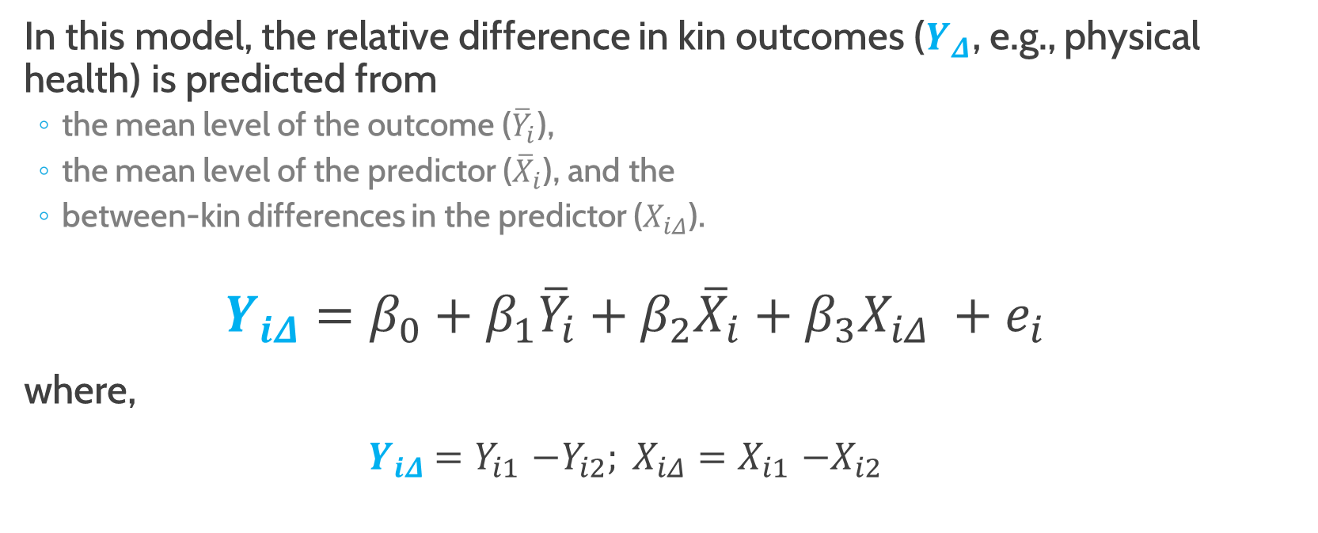
Discordant Kin Model
In this model, the relative difference in kin outcomes ($Y_{Δ}$, e.g., physical health) is predicted from
the mean level of the outcome (${\overline{Y}}_{i}$),
the mean level of the predictor (${\overline{X}}_{i}$), and the
between-kin differences in the predictor ($X_{iΔ}$).
$$Y_{iΔ}=β_{0}+β_{1}{\overline{Y}}_{i}+β_{2}{\overline{X}}_{i}+β_{3}X_{iΔ} +e_{i}$$
where,
$Y_{iΔ}$ ${=Y}_{i1}−Y_{i2}; X_{iΔ}{=X}_{i1}−X_{i2}$

Slide 37
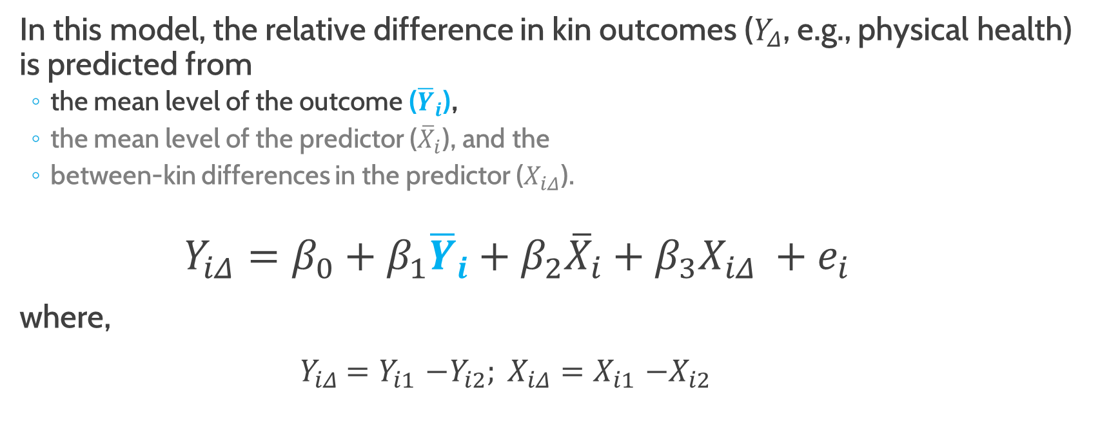
Discordant Kin Model
In this model, the relative difference in kin outcomes ($Y_{Δ}$, e.g., physical health) is predicted from
the mean level of the outcome (${\overline{Y}}_{i}$),
the mean level of the predictor (${\overline{X}}_{i}$), and the
between-kin differences in the predictor ($X_{iΔ}$).
$$Y_{iΔ}=β_{0}+β_{1}{\overline{Y}}_{i}+β_{2}{\overline{X}}_{i}+β_{3}X_{iΔ} +e_{i}$$
where,
$Y_{iΔ}$ ${=Y}_{i1}−Y_{i2}; X_{iΔ}{=X}_{i1}−X_{i2}$

Slide 38
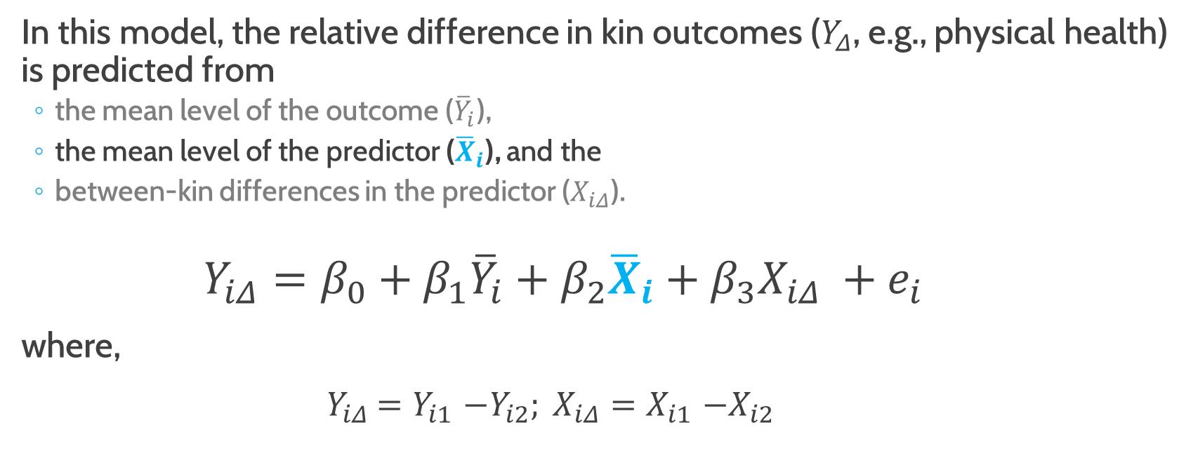
Discordant Kin Model
In this model, the relative difference in kin outcomes ($Y_{Δ}$, e.g., physical health) is predicted from
the mean level of the outcome (${\overline{Y}}_{i}$),
the mean level of the predictor (${\overline{X}}_{i}$), and the
between-kin differences in the predictor ($X_{iΔ}$).
$$Y_{iΔ}=β_{0}+β_{1}{\overline{Y}}_{i}+β_{2}{\overline{X}}_{i}+β_{3}X_{iΔ} +e_{i}$$
where,
$Y_{iΔ}$ ${=Y}_{i1}−Y_{i2}; X_{iΔ}{=X}_{i1}−X_{i2}$

Slide 39
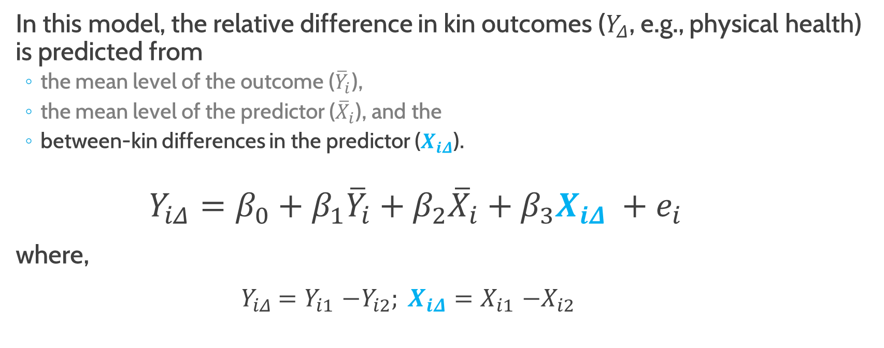
Discordant Kin Model
In this model, the relative difference in kin outcomes ($Y_{Δ}$, e.g., physical health) is predicted from
the mean level of the outcome (${\overline{Y}}_{i}$),
the mean level of the predictor (${\overline{X}}_{i}$), and the
between-kin differences in the predictor ($X_{iΔ}$).
$$Y_{iΔ}=β_{0}+β_{1}{\overline{Y}}_{i}+β_{2}{\overline{X}}_{i}+β_{3}X_{iΔ} +e_{i}$$
where,
$Y_{iΔ}$ ${=Y}_{i1}−Y_{i2}; X_{iΔ}{=X}_{i1}−X_{i2}$

Slide 40
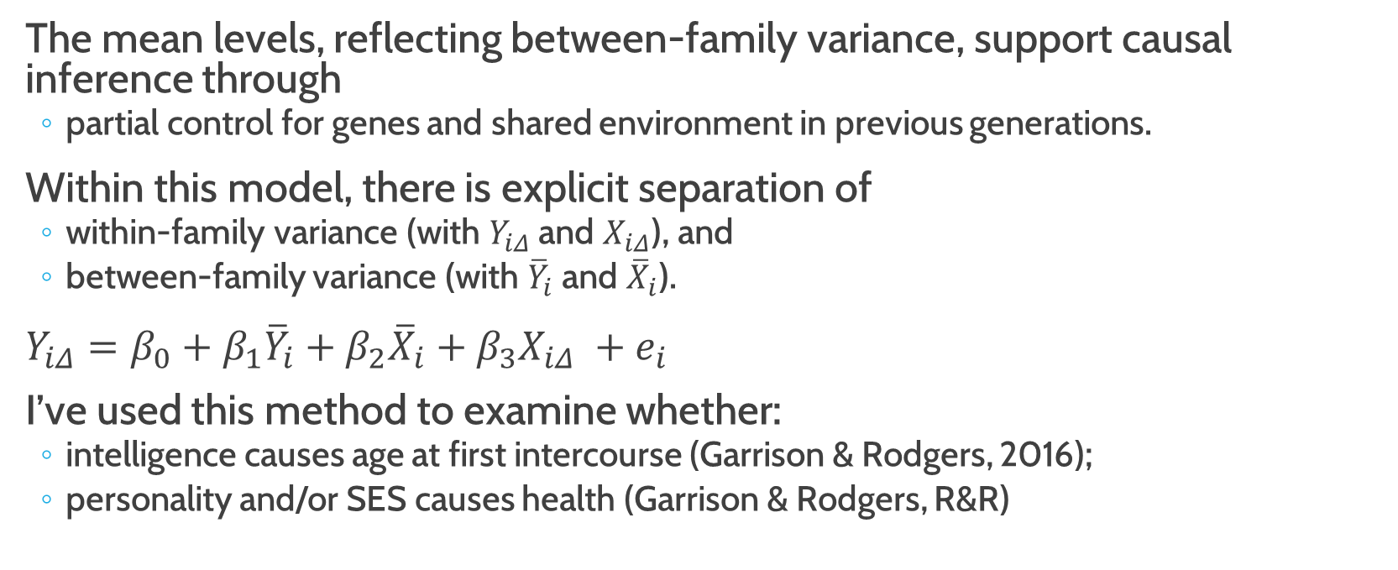
Discordant Kin Model
The mean levels, reflecting between-family variance, support causal inference through
partial control for genes and shared environment in previous generations.
Within this model, there is explicit separation of
within-family variance (with $Y_{iΔ}$ and $X_{iΔ}$), and
between-family variance (with ${\overline{Y}}_{i}$ and ${\overline{X}}_{i}$).
$Y_{iΔ}=β_{0}+β_{1}{\overline{Y}}_{i}+β_{2}{\overline{X}}_{i}+β_{3}X_{iΔ} +e_{i}$
I’ve used this method to examine whether:
intelligence causes age at first intercourse (Garrison & Rodgers, 2016);
personality and/or SES causes health (Garrison & Rodgers, R&R)

Slide 41
Illustration
Garrison & Rodgers (2016) Casting doubt on the causal link between intelligence and age at first intercourse: A cross-generational sibling comparison design using the NLSY. Intelligence, 59, 139-156.
Garrison & Rodgers (R&R) Using genetically-informed designs to test causal claims without experiments: Discordant-Sibling designs and applications for differential psychology. European Journal of Personality

Slide 42
Data
The National Longitudinal Survey of Youth (NLSY)
is an intergenerational survey,
based on a nationally representative household probability sample, and is
Supported by the US Bureau of Labor Statistics
On December 31, 1978, 12,686 adolescents were sampled
from 8,770 households (Gen1).

Slide 43
National Longitudinal Survey Of Youth
is an intergenerational survey,
based on a nationally representative household probability sample, and is
Supported by the US Bureau of Labor Statistics
On December 31, 1978, 12,686 adolescents were sampled
from 8,770 households (Gen1).

Slide 44
National Longitudinal Survey Of Youth
Their children were surveyed, starting in 1986 (11,521; Gen2).
In addition, basic information about Gen1’s parents (Gen0) and Gen2’s children (Gen3) has been collected.
This set of surveys contain 4 generations of data, but
this talk focuses on Gen1.

Slide 45
Kinship Links
We have identified and validated the kinship pairs within this dataset (Rodgers ... Garrison et al., 2016 @ Behavior Genetics).
Generation 1
≈ 4,000 Full Sibling Pairs
≈ 300 Half Sibling Pairs
≈ 125 Cousin Pairs
≈ 10 MZ Twin Pairs

Slide 46
Kinship Categories
Not Raised in the Same Home
Raised in the Same Home
Parent-Child (11,504)
Aunt-Nibling (9,884), whose mothers were
MZ Twins
Ambiguous Twins
Full Siblings
Ambiguous Siblings
Half Siblings
Full Cousins
Ambiguous Cousins
Unrelated Housemates
Cousins (4,995), whose mothers were
MZ Twins
Ambiguous Twins
Full Siblings
Ambiguous Siblings
Half Siblings
Full Cousins
Ambiguous Cousins
Unrelated Housemates
MZ Twins (38)
Ambiguous Twins (23)
Full Siblings (11,003)
Ambiguous Siblings (631)
Half Siblings (3,739)
Full Cousins (96)
Ambiguous Cousins (179)
Unrelated Housemates (1,264)
Total: 42,773
Notes:
Note that these data are publicly available…

Slide 47
Illustration
SES at Age 40 on Physical Health (Age 40)
SES at Age 40 on Mental Health (Age 40)
Measures
SES measure is
based on Myrianthopoulos and French (1968) and used more recently by Turkheimer, Haley, Waldron, D’Onofrio, and Gottesman (2003).
aggregate score based on the mean of their total net family income, education, and occupation quantile scores.
Health
SF-12 Physical Component Summary Score (PCS)
SF-12 Mental Component Summary Score (MCS)

Slide 48
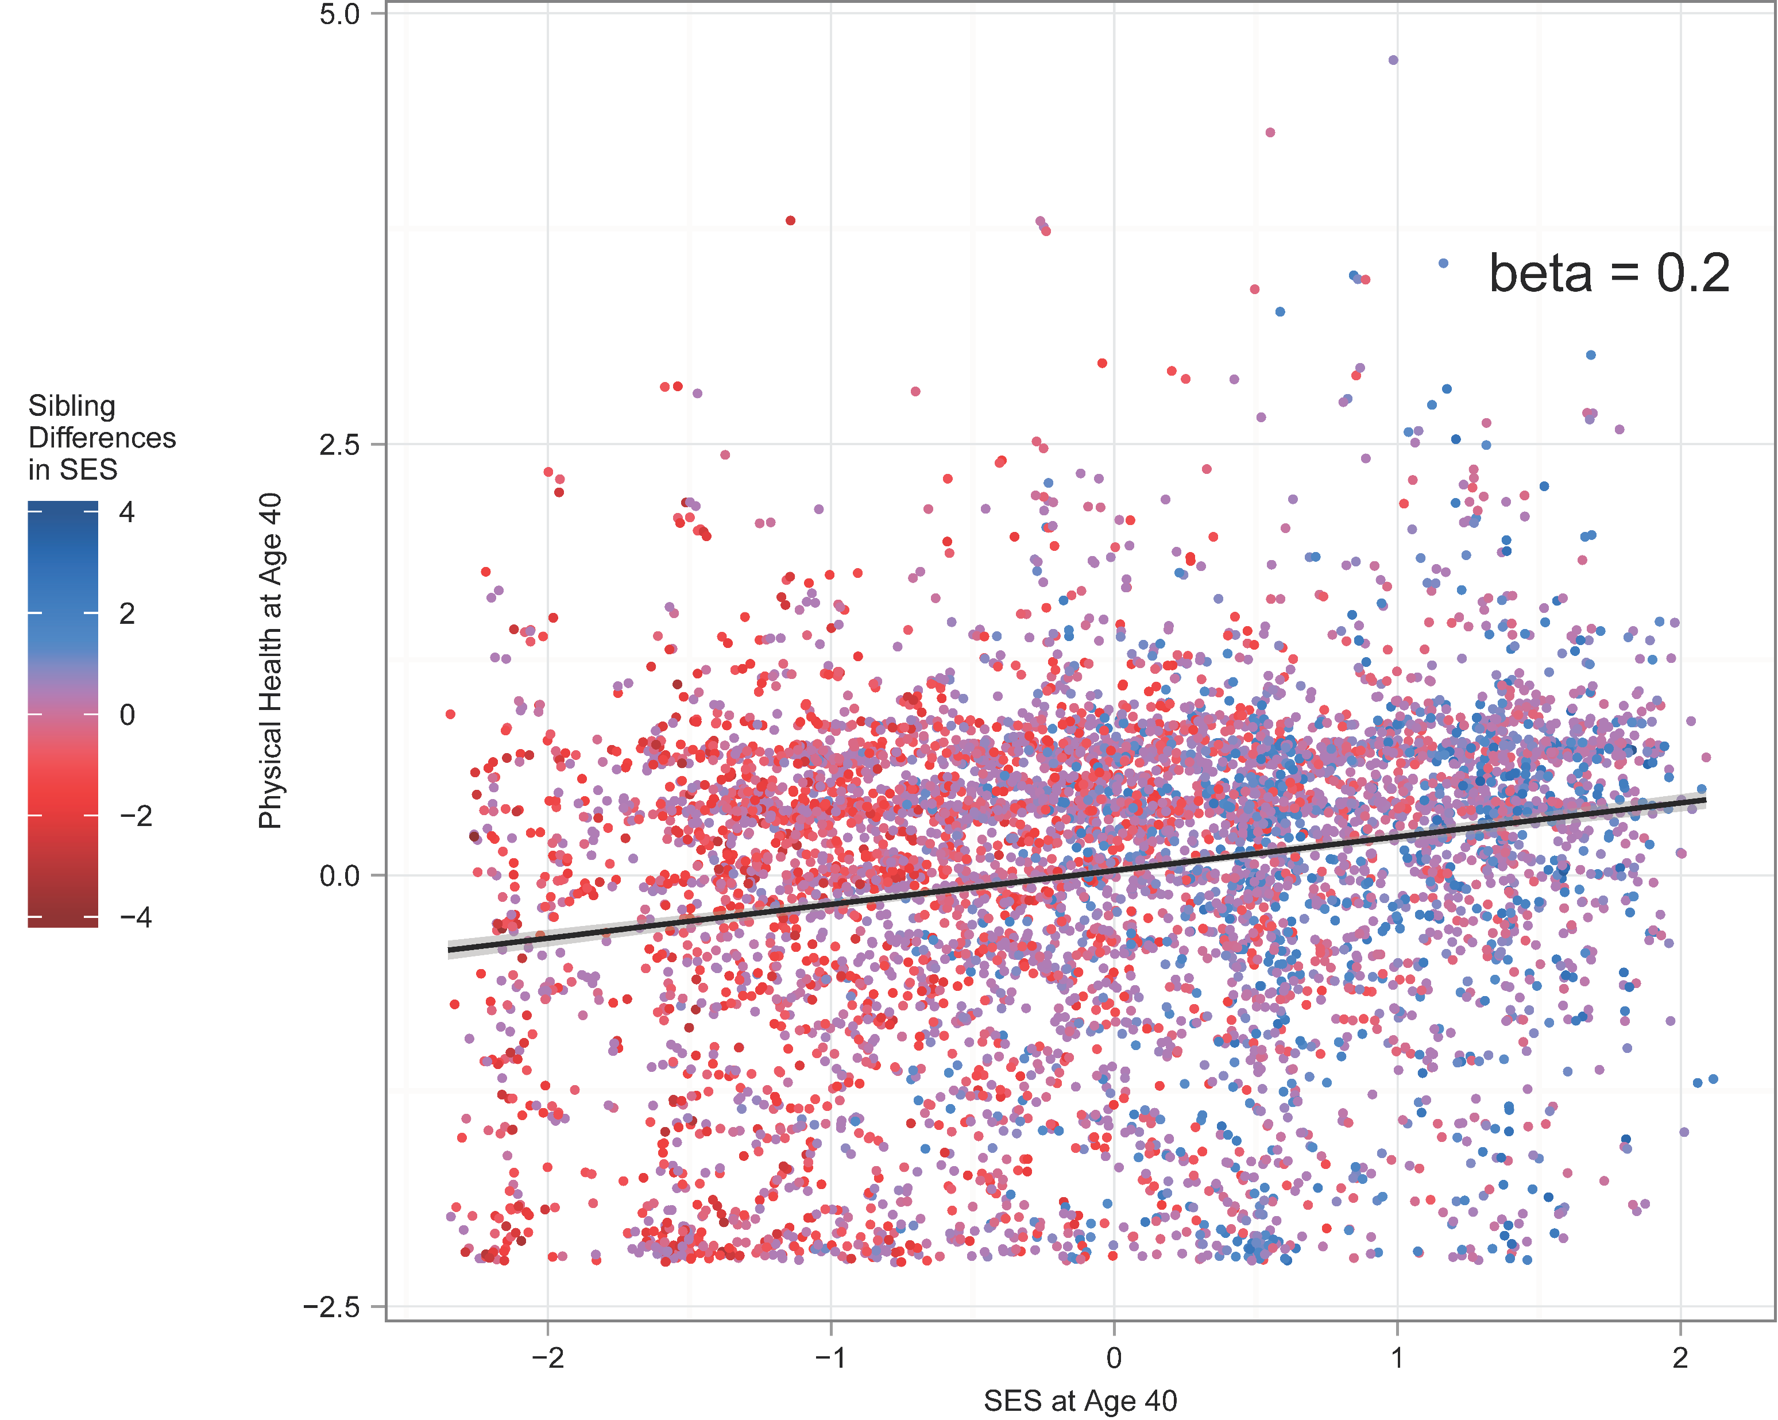
SES VS. PHYSICAL HEALTH

Slide 49
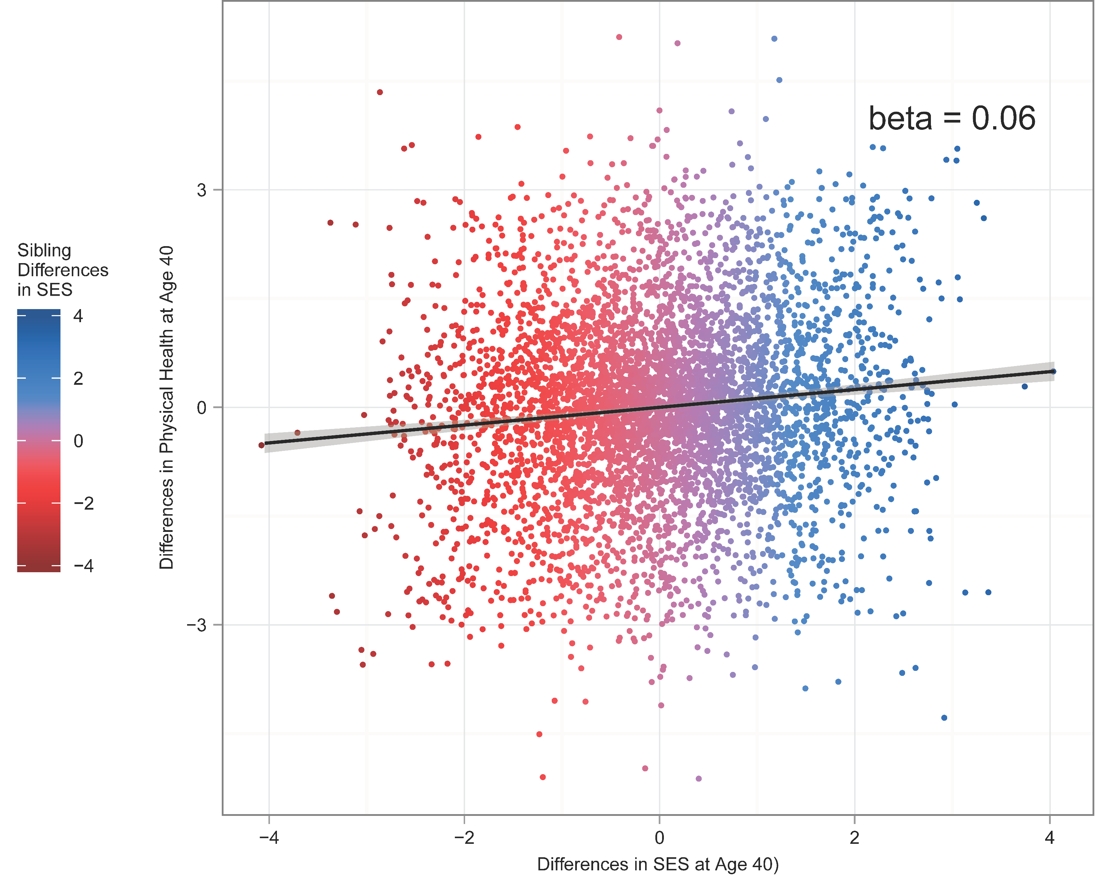

$Δ$ SES VS. $Δ$ PHYSICAL HEALTH

Slide 50
Physical Health Results
 | Estimate | SE | t value | P(>|t|)
Intercept | 0.97 | 0.02 | 60.86 | <0.001
Mean Health | -0.33 | 0.02 | -14.22 | <0.001
Mean SES | -0.01 | 0.02 | -0.30 | 0.765
Difference in SES | 0.06 | 0.01 | 3.21 | 0.001
Multiple R-square = 0.084 F-statistic 78.9 on 3 and 2575 DF
Notes:
Significant Difference Score
Implies Within-Family Sources of Covariation (beyond familial effects)
Probably Non-Shared Environmental in origin
But possibly genetic because we only partially control for genetics

Slide 51
Interpretation
Significant Difference Score
Implies Within-Family Sources of Covariation (beyond familial effects)
Probably Non-Shared Environmental in origin
But possibly genetic because we only partially control for genetics

Slide 52
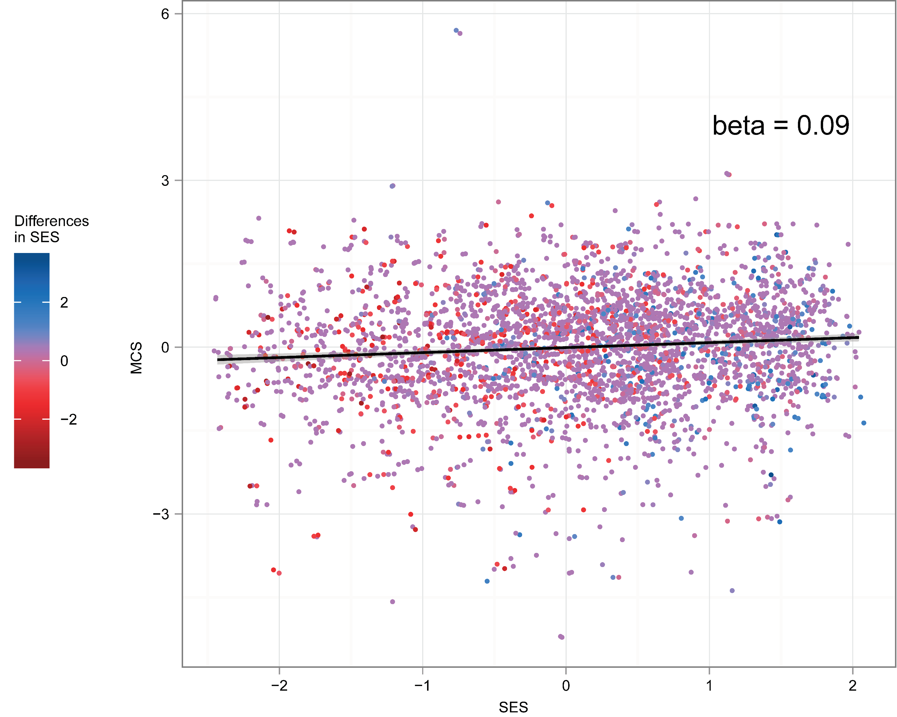
SES VS. MENTAL HEALTH

Slide 53
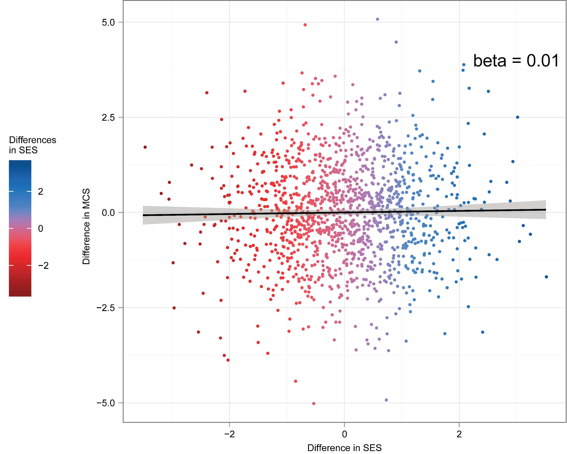

$Δ$ SES VS. $Δ$ MENTAL HEALTH

Slide 54
Mental Health Results
 | Estimate | SE | t value | P(>|t|)
Intercept | 1.00 | 0.03 | 31.92 | <0.001
Mean Health | -0.32 | 0.04 | -7.67 | <0.001
Mean SES | -0.02 | 0.04 | -0.03 | 0.98
Difference in SES | 0.01 | 0.03 | 0.32 | 0.75
Multiple R-square = 0.081 F-statistic 20 on 3 and 675 DF
Notes:
Non-significant Difference Score
Implies Between-Family Sources of Covariation (i.e., familial effects)
Either Genetic or Shared-Environmental in Origin

Slide 55
Interpretation
Non-significant Difference Score
Implies Between-Family Sources of Covariation (i.e., familial effects)
Either Genetic or Shared-Environmental in Origin

Slide 56
Empirical Confirmation
Garrison & Rodgers (in press). Decomposing the Causes of the Socioeconomic Status-Health Gradient with Biometrical Modeling. Journal of Personality and Social Psychology

Slide 57
Discordant versus Behavior Genetics
Are the Discordant Kinship Results consistent with Traditional Behavior Genetic Findings?
The two illustrations suggest different pathways
Mental Health’s Relationship with SES seems to be familial, whereas
Physical Health’s Relationship with SES seems to include non-familial effects
Do these interpretations jibe when we apply traditional behavior genetic models?
If so, then the correlation between Mental Health and SES
should be entirely explained by familial effects (Genetic and/or Shared-Environmental Covariance), and
The correlation between Physical Health and SES
should be not be entirely explained by familial (Genetic and/or Shared-Environmental) Covariance

Slide 58
Steps to Decompose the Correlation
Step 1
Conduct Univariate ACE models
Variance is partitioned into familial (A² & C²) and non-familial (E²)
Step 2
Conduct Bivariate ACE model
Covariance is partitioned into familial (rA & rC) and non-familial (rE)

Slide 59
Univariate ACE Model Specification
cor_{c}
1 if raised together; 0 if not
cor_{a}
varies by
level of relatedness
e₁
c₁
a₁
a₂
c₂
e₂
λ_{e} λ_{c} λ_{a}
λ_{e} λ_{c} λ_{a}
SES₁
SES₂
Each type of kinship pair (full sibling, etc) has their own path diagram

Slide 60
Univariate ACE Model Specification
cor_{c}
1 if raised together; 0 if not
cor_{a}
varies by
level of relatedness
e₁
c₁
a₁
a₂
c₂
e₂
λ_{e} λ_{c} λ_{a}
λ_{e} λ_{c} λ_{a}
SES₁
SES₂
Each type of kinship pair (full sibling, etc) has their own path diagram

Slide 61
Univariate Results
 | ACE SES | AE PCS | CE MCS
a² | .57 | .17
c² | .08 |  | .09
e² | .35 | .83 | .91
Proportion of Variance attributable to Covariates | .05 | .02 | .02
p(ChiSqM, df≈25) | .07 | .09 | .8
CFI | .99 | .92 | 1.00
TLI | .99 | .94 | 1.00
RMSEA (90CI) | .02 (0, .03) | .02 (0, .03) | 0 (0, .01)
SRMR | .02 | .02 | .02
e₁
c₁
a₁
λ_{e} λ_{c} λ_{a}
SES₁

Slide 62
Bivariate ACE Model Specification
cov_{c}
cov_{a}
e₁
c₁
a₁
a₁
c₁
e₁
λ_{e} λ_{c} λ_{a}
λ_{e} λ_{c} λ_{a}
SES₁
PCS₁
Bivariate Correlation doesn’t vary by kinship pair

Slide 63
Bivariate ACE Model Specification
(Familial Covariance)
cov_{c}
cov_{a}
e₁
c₁
a₁
a₁
c₁
e₁
λ_{e} λ_{c} λ_{a}
λ_{e} λ_{c} λ_{a}
SES₁
PCS₁
Bivariate Correlation doesn’t vary by kinship pair

Slide 64
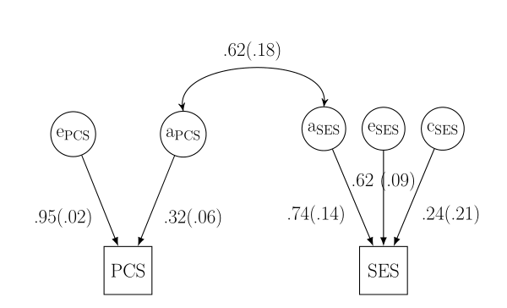
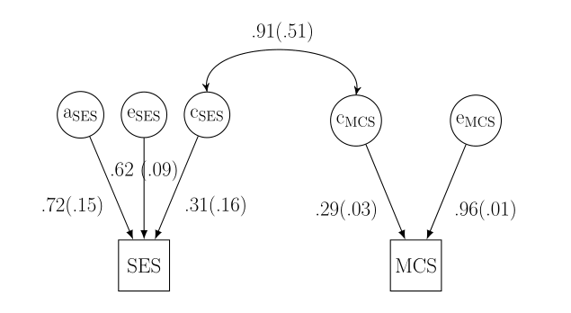
Bivariate Results
SES and Physical Health
SES and Mental Health

Slide 65
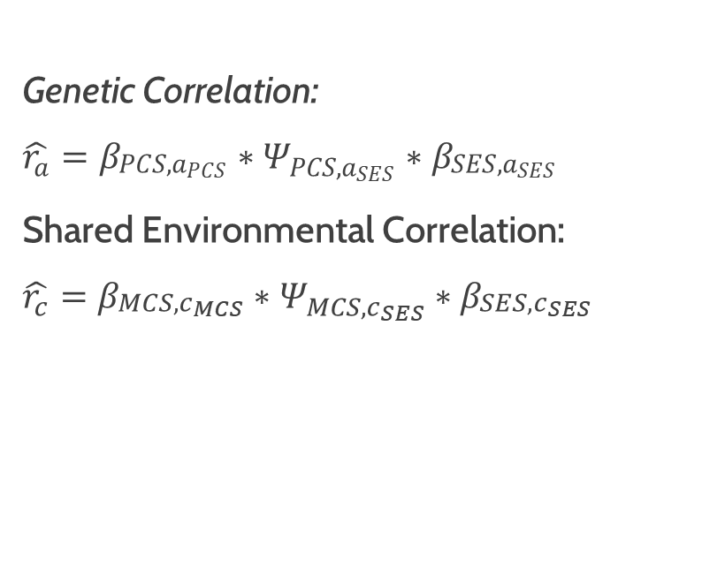
Bivariate Results Summary
 | PCS & SES | MCS & SES
Familial Correlation | .15 | .08
Total Correlation | .2 | .08
Genetic Correlation | .15 | 0
Shared-Environmental Correlation | 0 | .08
χ2 (df) | 151(62) | 65.6(62)
CFI | .92 | .996
TLI | .93 | .997
RMSEA (90CI) | .03 (.03, .04) | .01 (0, .02)
p(RMSEA) <.05 | 1 | 1
SRMR | .04 | .02
Genetic Correlation:
$\hat{r_{a}}=β_{\begin{aligned}PCS,a_{PCS} \\ \end{aligned}}∗Ψ_{PCS,a_{SES}}∗β_{\begin{aligned}SES,a_{SES} \\ \end{aligned}}$
Shared Environmental Correlation:
$\hat{r_{c}}=β_{\begin{aligned}MCS,c_{MCS} \\ \end{aligned}}∗Ψ_{MCS,c_{SES}}∗β_{\begin{aligned}SES,c_{SES} \\ \end{aligned}}$

Slide 66
Interpretation
Behavior Genetic Results are Consistent with the Discordant Findings
Correlation between SES and Physical Health:
had both within-family (.15) and between family (.05) variance
Correlation between SES and Mental Health:
had only within-family (.08) and no between family (0) variance

Slide 67
Integrating these findings within the substantive literature
Broad Theory | Summary | Possible Biometrical Implications
Social Causation (Adler et al., 1994; Wagstaff & Doorslaer, 2000) | An individual’s social standing affects their health | (Non-Shared) Environmental Pathways
Social Selection (Haas, 2006) | Health affects people’s abilities to climb the social ladder | (Shared-)Environmental Pathways
Social Confounding (Deary et al., 2010; Gottfredson, 2004) | Third variables (e.g., personality, intelligence) influence both social standing and health | Genetic Pathways

Slide 68
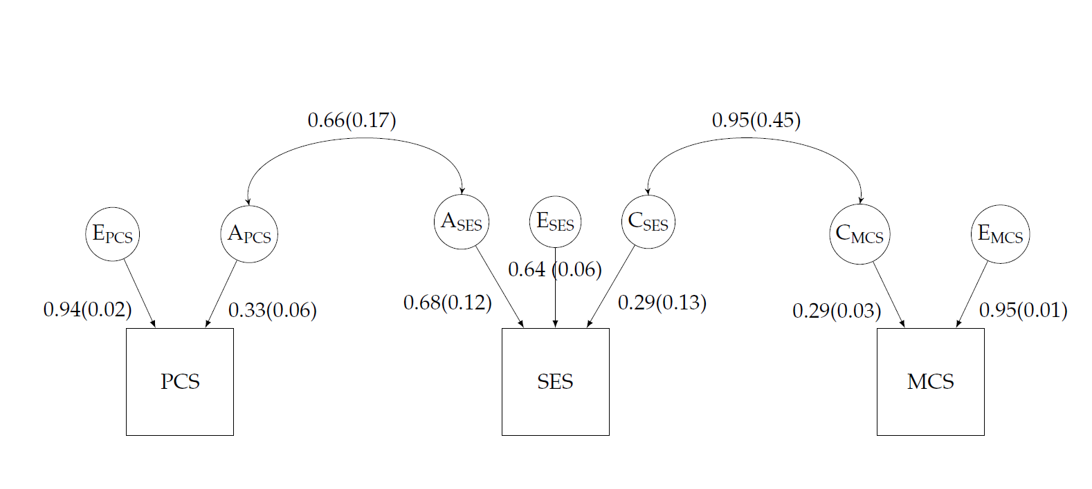
Trivariate Results

Slide 69
Simulation
Does this model work outside the NLSY?

Slide 70
Beyond Empirical Illustration
Thus far, I have examined the discordant kinship model using NLSY data.
Empirical illustrations, while compelling, are limited.
We don’t know the underlying structure
We can only guess
How does this model perform with
twins?
adopted siblings?
large correlations?
small correlations?
Is it adequately powered?
$$Y_{iΔ}=β_{0}+β_{1}{\overline{Y}}_{i}+β_{2}{\overline{X}}_{i}+β_{3}X_{iΔ} +e_{i}$$

Slide 71
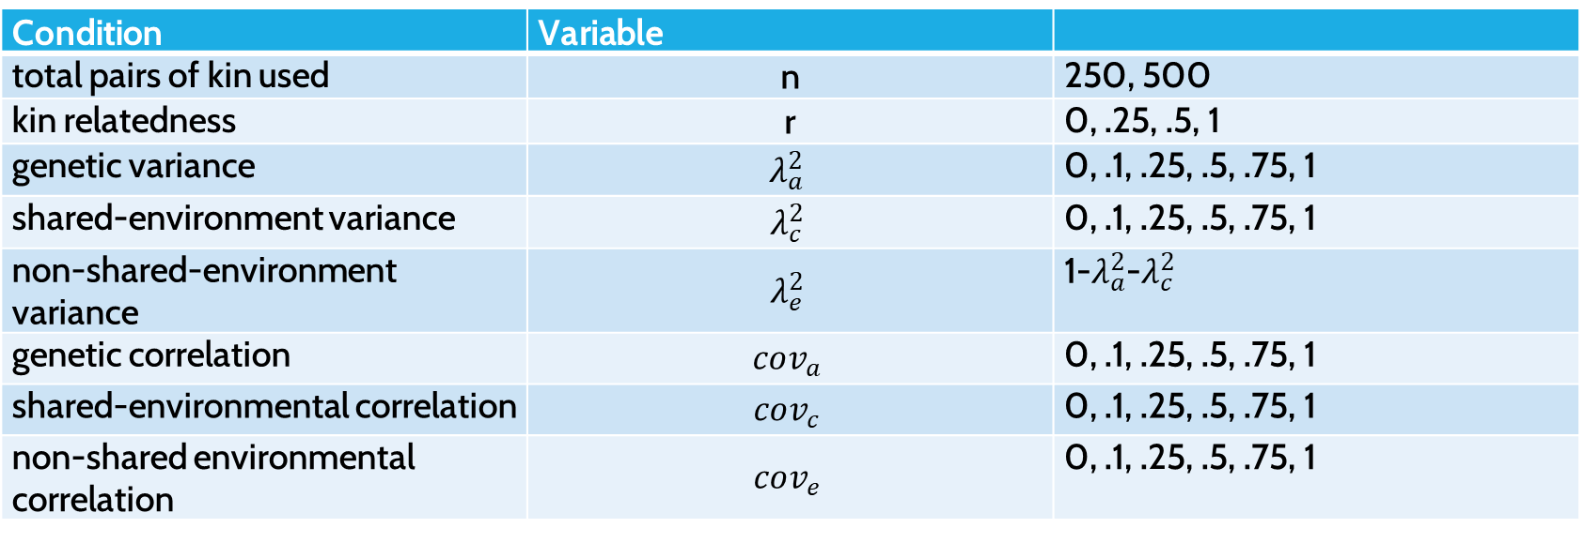
Simulation Conditions
Condition | Variable
total pairs of kin used | n | 250, 500
kin relatedness | r | 0, .25, .5, 1
genetic variance | $$λ_{a}^{2}$$ | 0, .1, .25, .5, .75, 1
shared-environment variance | $$λ_{c}^{2}$$ | 0, .1, .25, .5, .75, 1
non-shared-environment variance | $$λ_{e}^{2}$$ | 1-$λ_{a}^{2}$-$λ_{c}^{2}$
genetic correlation | $$cov_{a}$$ | 0, .1, .25, .5, .75, 1
shared-environmental correlation | $$cov_{c}$$ | 0, .1, .25, .5, .75, 1
non-shared environmental correlation | $$cov_{e}$$ | 0, .1, .25, .5, .75, 1
1000 Replications; see Garrison & Ream (2018). discord: Functions for Discordant Kinship Modeling R package

Slide 72
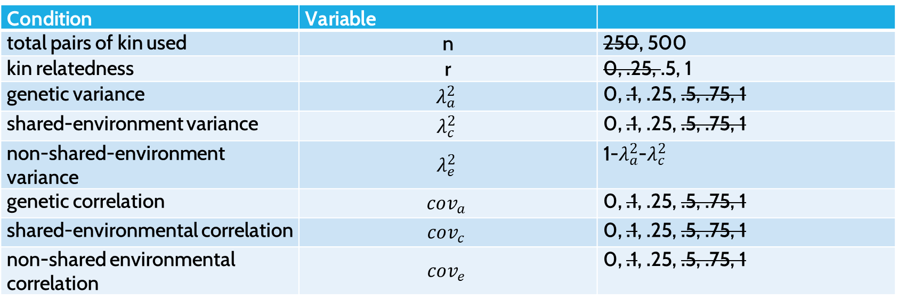
Simulation Conditions Subset
Condition | Variable
total pairs of kin used | n | 250, 500
kin relatedness | r | 0, .25, .5, 1
genetic variance | $$λ_{a}^{2}$$ | 0, .1, .25, .5, .75, 1
shared-environment variance | $$λ_{c}^{2}$$ | 0, .1, .25, .5, .75, 1
non-shared-environment variance | $$λ_{e}^{2}$$ | 1-$λ_{a}^{2}$-$λ_{c}^{2}$
genetic correlation | $$cov_{a}$$ | 0, .1, .25, .5, .75, 1
shared-environmental correlation | $$cov_{c}$$ | 0, .1, .25, .5, .75, 1
non-shared environmental correlation | $$cov_{e}$$ | 0, .1, .25, .5, .75, 1
1000 Replications; see Garrison & Ream (2018). discord: Functions for Discordant Kinship Modeling R package

Slide 73
Findings
$$Y_{iΔ}=β_{0}+β_{1}{\overline{Y}}_{i}+β_{2}{\overline{X}}_{i}+β_{3}X_{iΔ} +e_{i}$$
Relatedness | Phenotypic Correlation | Genetic Covariance | Shared Environmental Covariance | Nonshared Environmental Covariance | Significant Difference Score and F test
1 | 0 | 0 | 0 | 0 | 19
1 | 0.06 | 0.25 | 0 | 0 | 16
1 | 0.06 | 0 | 0.25 | 0 | 11
1 | 0.13 | 0.25 | 0.25 | 0 | 21
1 | 0.13 | 0 | 0 | 0.25 | 808
1 | 0.19 | 0.25 | 0 | 0.25 | 829
1 | 0.19 | 0 | 0.25 | 0.25 | 817
1 | 0.25 | 0.25 | 0.25 | 0.25 | 823
0.5 | 0 | 0 | 0 | 0 | 15
0.5 | 0.06 | 0.25 | 0 | 0 | 47
0.5 | 0.06 | 0 | 0.25 | 0 | 16
0.5 | 0.13 | 0.25 | 0.25 | 0 | 51
0.5 | 0.13 | 0 | 0 | 0.25 | 586
0.5 | 0.19 | 0.25 | 0 | 0.25 | 854
0.5 | 0.19 | 0 | 0.25 | 0.25 | 614
0.5 | 0.25 | 0.25 | 0.25 | 0.25 | 841

Slide 74
Findings
$$Y_{iΔ}=β_{0}+β_{1}{\overline{Y}}_{i}+β_{2}{\overline{X}}_{i}+β_{3}X_{iΔ} +e_{i}$$
Relatedness | Phenotypic Correlation | Genetic Covariance | Shared Environmental Covariance | Nonshared Environmental Covariance | Significant Difference Score and F test
1 | 0 | 0 | 0 | 0 | 19
1 | 0.06 | 0.25 | 0 | 0 | 16
1 | 0.06 | 0 | 0.25 | 0 | 11
1 | 0.13 | 0.25 | 0.25 | 0 | 21
1 | 0.13 | 0 | 0 | 0.25 | 808
1 | 0.19 | 0.25 | 0 | 0.25 | 829
1 | 0.19 | 0 | 0.25 | 0.25 | 817
1 | 0.25 | 0.25 | 0.25 | 0.25 | 823
0.5 | 0 | 0 | 0 | 0 | 15
0.5 | 0.06 | 0.25 | 0 | 0 | 47
0.5 | 0.06 | 0 | 0.25 | 0 | 16
0.5 | 0.13 | 0.25 | 0.25 | 0 | 51
0.5 | 0.13 | 0 | 0 | 0.25 | 586
0.5 | 0.19 | 0.25 | 0 | 0.25 | 854
0.5 | 0.19 | 0 | 0.25 | 0.25 | 614
0.5 | 0.25 | 0.25 | 0.25 | 0.25 | 841

Slide 75
Findings
$$Y_{iΔ}=β_{0}+β_{1}{\overline{Y}}_{i}+β_{2}{\overline{X}}_{i}+β_{3}X_{iΔ} +e_{i}$$
Relatedness | Phenotypic Correlation | Genetic Covariance | Shared Environmental Covariance | Nonshared Environmental Covariance | Significant Difference Score and F test
1 | 0 | 0 | 0 | 0 | 19
1 | 0.06 | 0.25 | 0 | 0 | 16
1 | 0.06 | 0 | 0.25 | 0 | 11
1 | 0.13 | 0.25 | 0.25 | 0 | 21
1 | 0.13 | 0 | 0 | 0.25 | 808
1 | 0.19 | 0.25 | 0 | 0.25 | 829
1 | 0.19 | 0 | 0.25 | 0.25 | 817
1 | 0.25 | 0.25 | 0.25 | 0.25 | 823
0.5 | 0 | 0 | 0 | 0 | 15
0.5 | 0.06 | 0.25 | 0 | 0 | 47
0.5 | 0.06 | 0 | 0.25 | 0 | 16
0.5 | 0.13 | 0.25 | 0.25 | 0 | 51
0.5 | 0.13 | 0 | 0 | 0.25 | 586
0.5 | 0.19 | 0.25 | 0 | 0.25 | 854
0.5 | 0.19 | 0 | 0.25 | 0.25 | 614
0.5 | 0.25 | 0.25 | 0.25 | 0.25 | 841

Slide 76
Findings
$$Y_{iΔ}=β_{0}+β_{1}{\overline{Y}}_{i}+β_{2}{\overline{X}}_{i}+β_{3}X_{iΔ} +e_{i}$$
Relatedness | Phenotypic Correlation | Genetic Covariance | Shared Environmental Covariance | Nonshared Environmental Covariance | Significant Difference Score and F test
1 | 0 | 0 | 0 | 0 | 19
1 | 0.06 | 0.25 | 0 | 0 | 16
1 | 0.06 | 0 | 0.25 | 0 | 11
1 | 0.13 | 0.25 | 0.25 | 0 | 21
1 | 0.13 | 0 | 0 | 0.25 | 808
1 | 0.19 | 0.25 | 0 | 0.25 | 829
1 | 0.19 | 0 | 0.25 | 0.25 | 817
1 | 0.25 | 0.25 | 0.25 | 0.25 | 823
0.5 | 0 | 0 | 0 | 0 | 15
0.5 | 0.06 | 0.25 | 0 | 0 | 47
0.5 | 0.06 | 0 | 0.25 | 0 | 16
0.5 | 0.13 | 0.25 | 0.25 | 0 | 51
0.5 | 0.13 | 0 | 0 | 0.25 | 586
0.5 | 0.19 | 0.25 | 0 | 0.25 | 854
0.5 | 0.19 | 0 | 0.25 | 0.25 | 614
0.5 | 0.25 | 0.25 | 0.25 | 0.25 | 841

Slide 77
Interpretation
Empirical Alpha (Type 1 Error) was <.05 for both MZ and Full Siblings
Power was greater for MZ twins
Full Siblings only partially controlled for Genetic Sources

Slide 78
Recall: 3 Appealing Design Features Of Experiments
treatment assignment is objective,
they are “automatically designed without access to any outcome data,”(Rubin, 2008) and
all pre-treatment covariates are “balanced” across conditions.

Slide 79
Recall: 3 Appealing Design Features Of Experiments
treatment assignment is objective,
Within a kin pair, the kin are assigned based on whichever has more of outcome.
Yi1 > Yi2
they are “automatically designed without access to any outcome data,”(Rubin, 2008) and
all pre-treatment covariates are “balanced” across conditions.

Slide 80
Recall: 3 Appealing Design Features Of Experiments
treatment assignment is objective,
they are “automatically designed without access to any outcome data,”(Rubin, 2008) and
The design is automatic... but it requires the outcome data.
all pre-treatment covariates are “balanced” across conditions.

Slide 81
Recall: 3 Appealing Design Features Of Experiments
treatment assignment is objective,
they are “automatically designed without access to any outcome data,”(Rubin, 2008) and
all pre-treatment covariates are “balanced” across conditions.
Within MZ sibling pairs,
all background covariates (genetic and otherwise) are balanced at birth.
Within Full sibling pairs,
Many, but not all, background covariates are balanced at birth.

Slide 82





Acknowledgements

Slide 83
Questions?

